Slide 1
GHANA CALIBRATION
1km

Slide 2
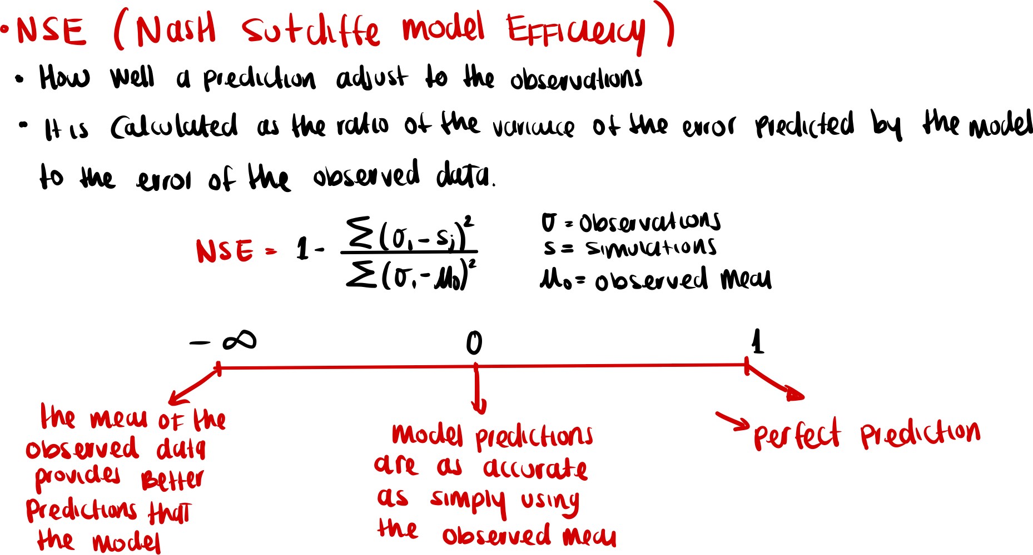

Slide 3
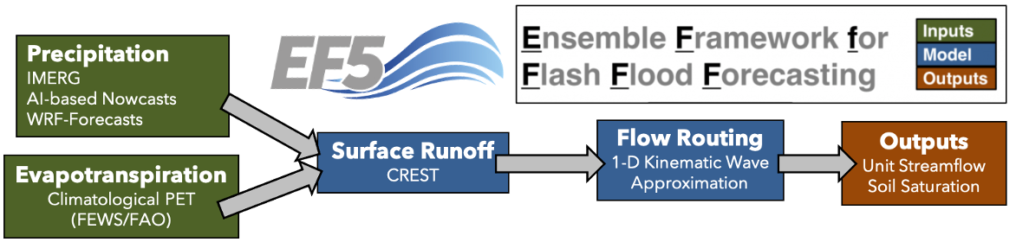
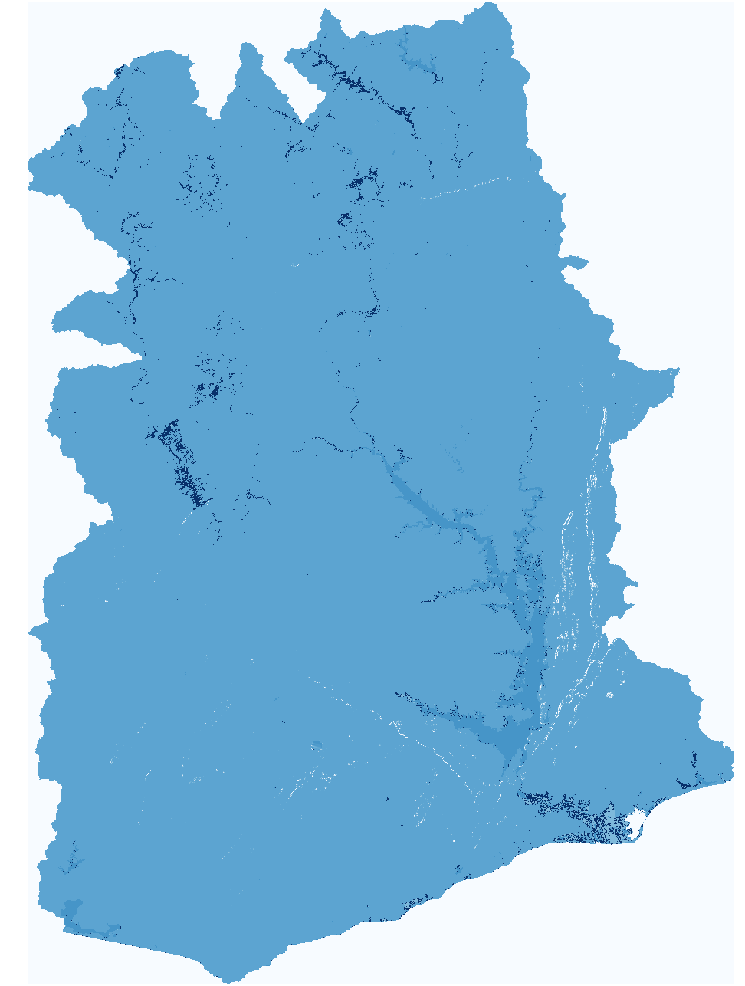
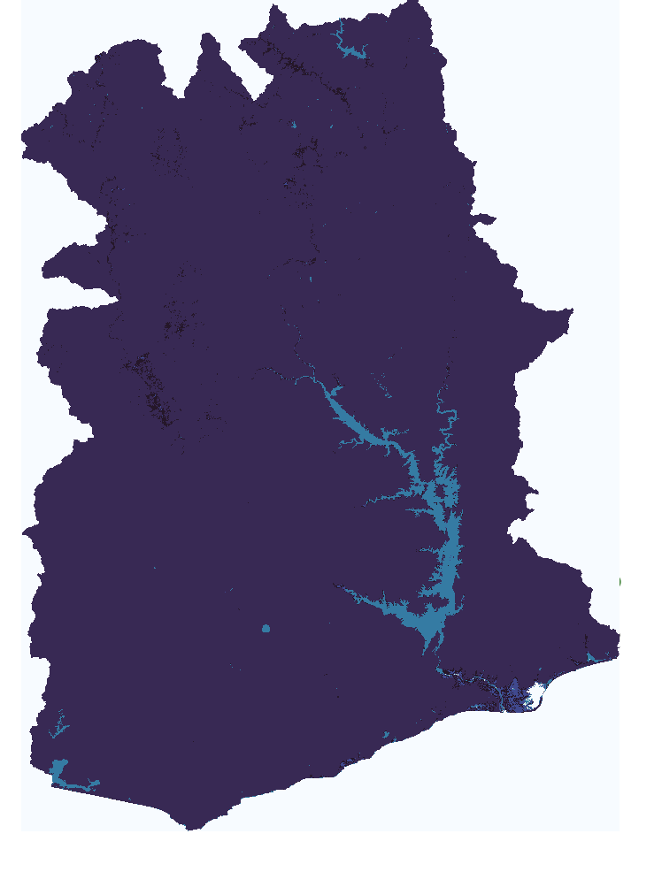
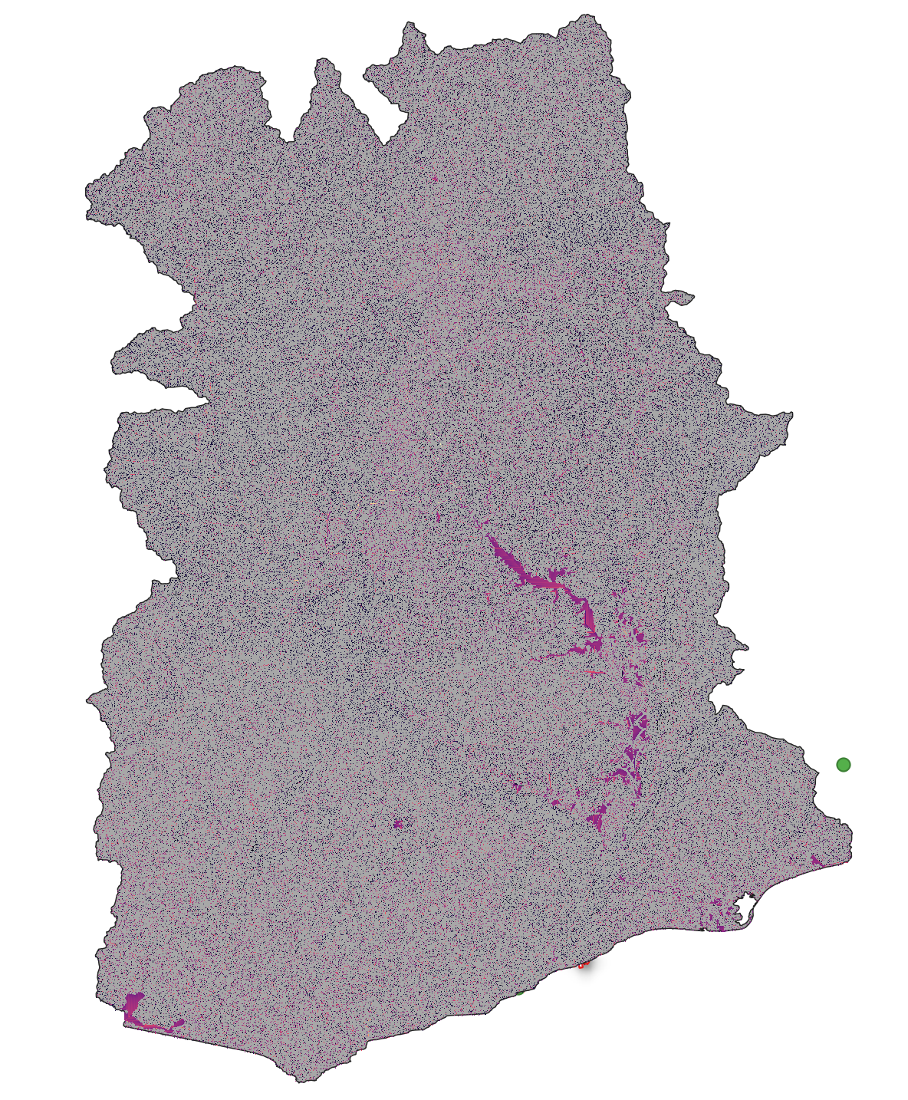
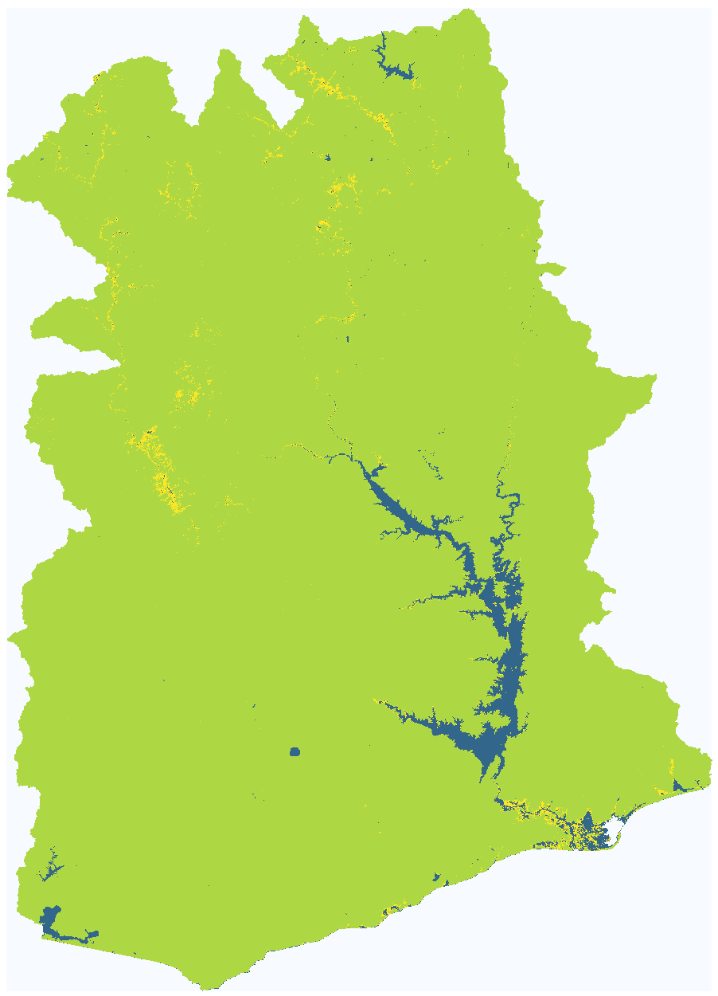
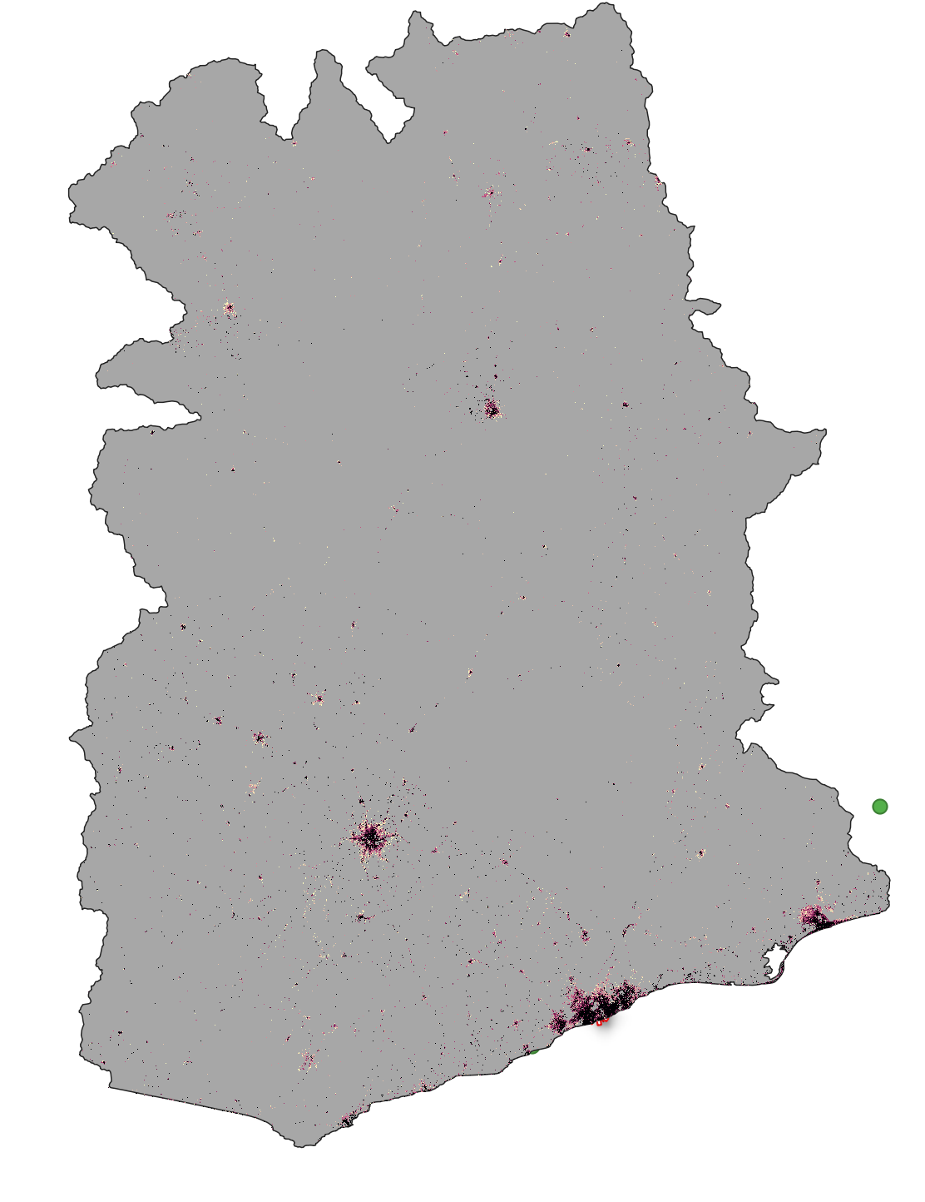
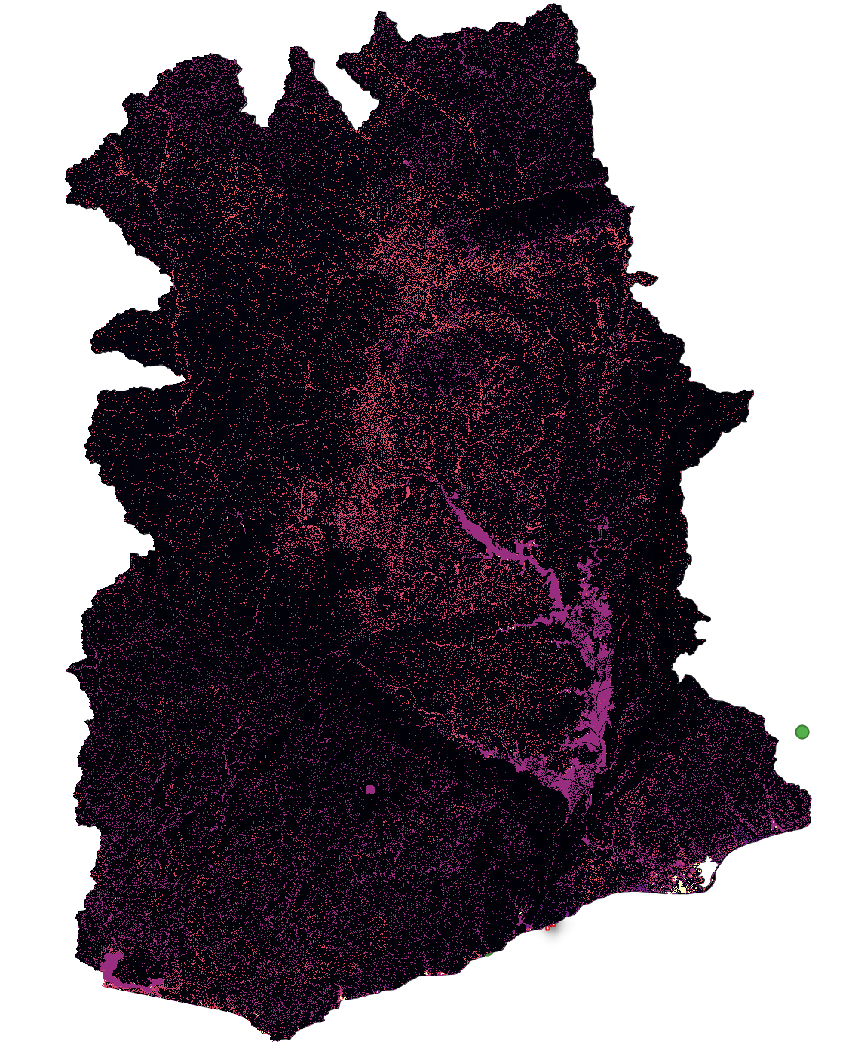
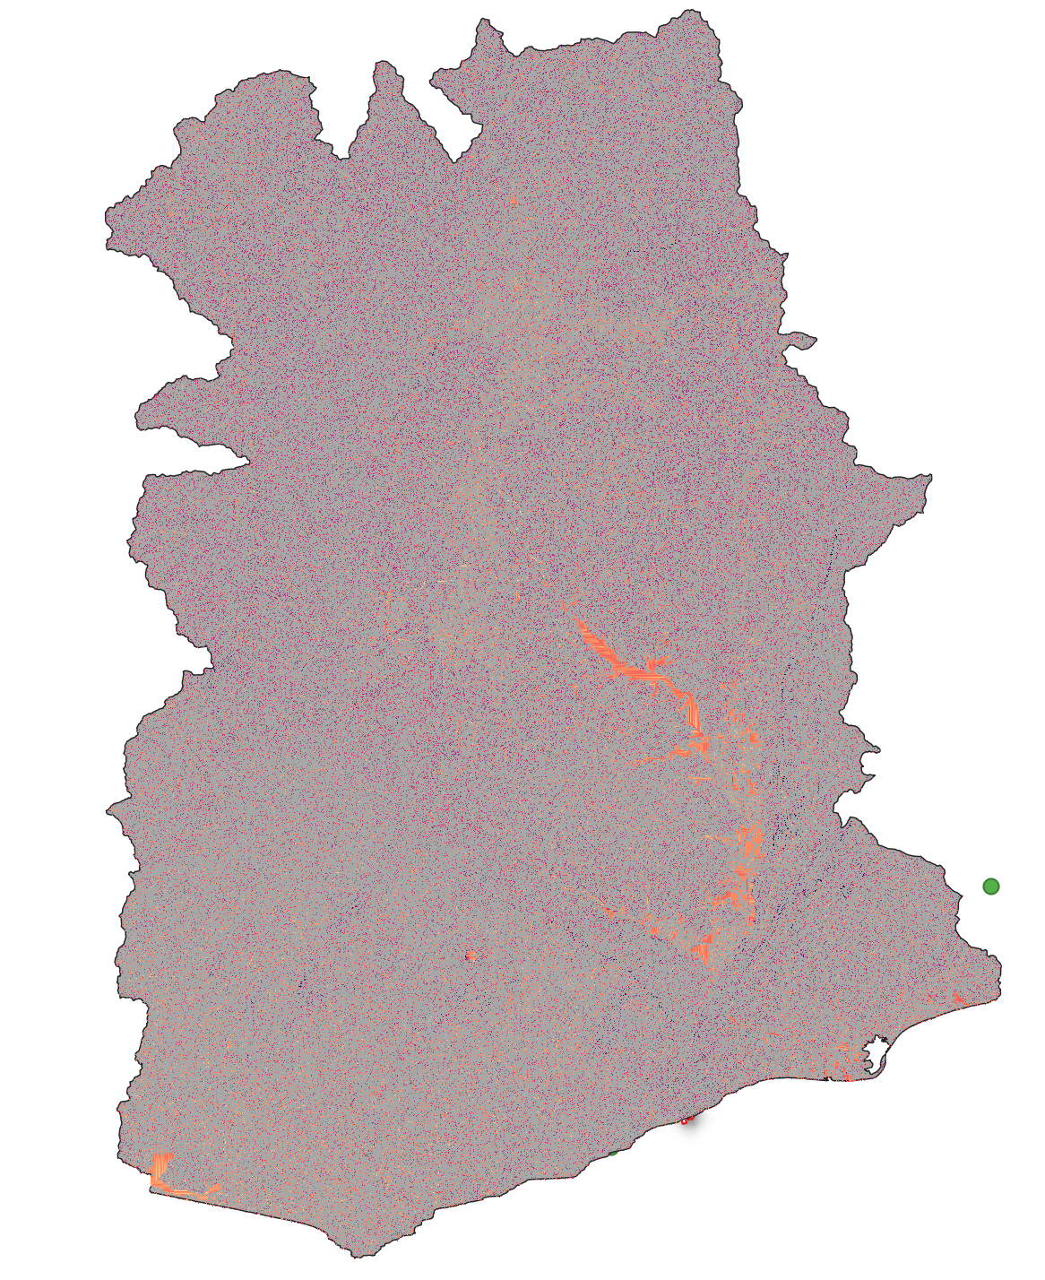
Ghana90m Baseline
wm
ksat
alpha
b
im
alpha0
beta

Slide 4
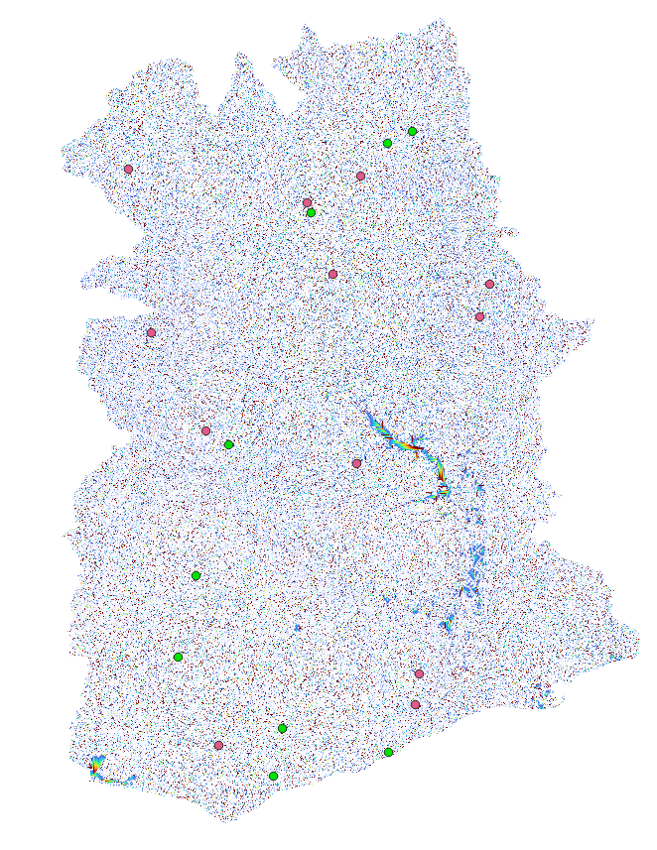
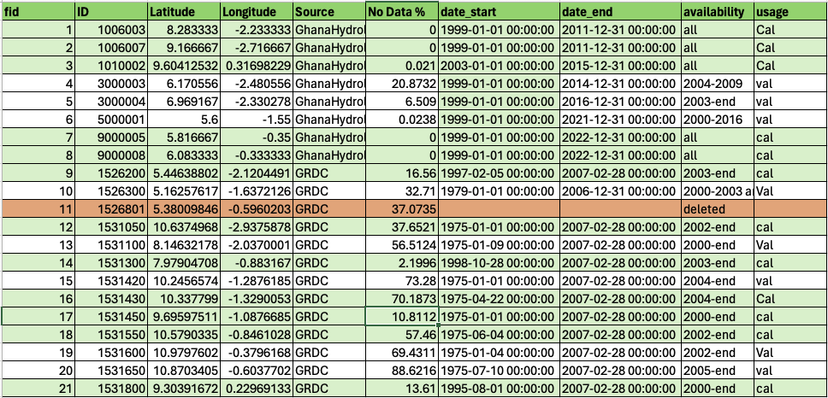
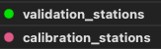
Gauge stations at 90m.
We currently have 21 stations.
We run with 20 stastations

Slide 5

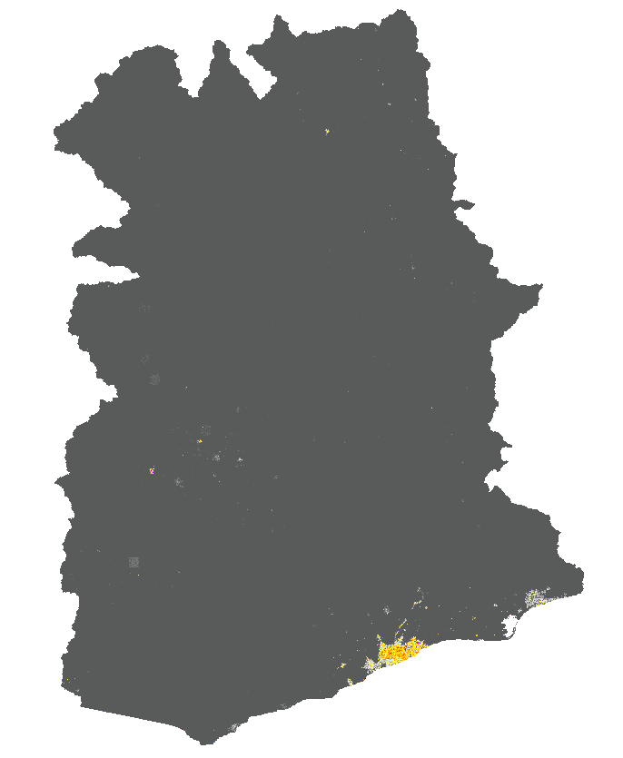
Impervious surface layer changes

Slide 6
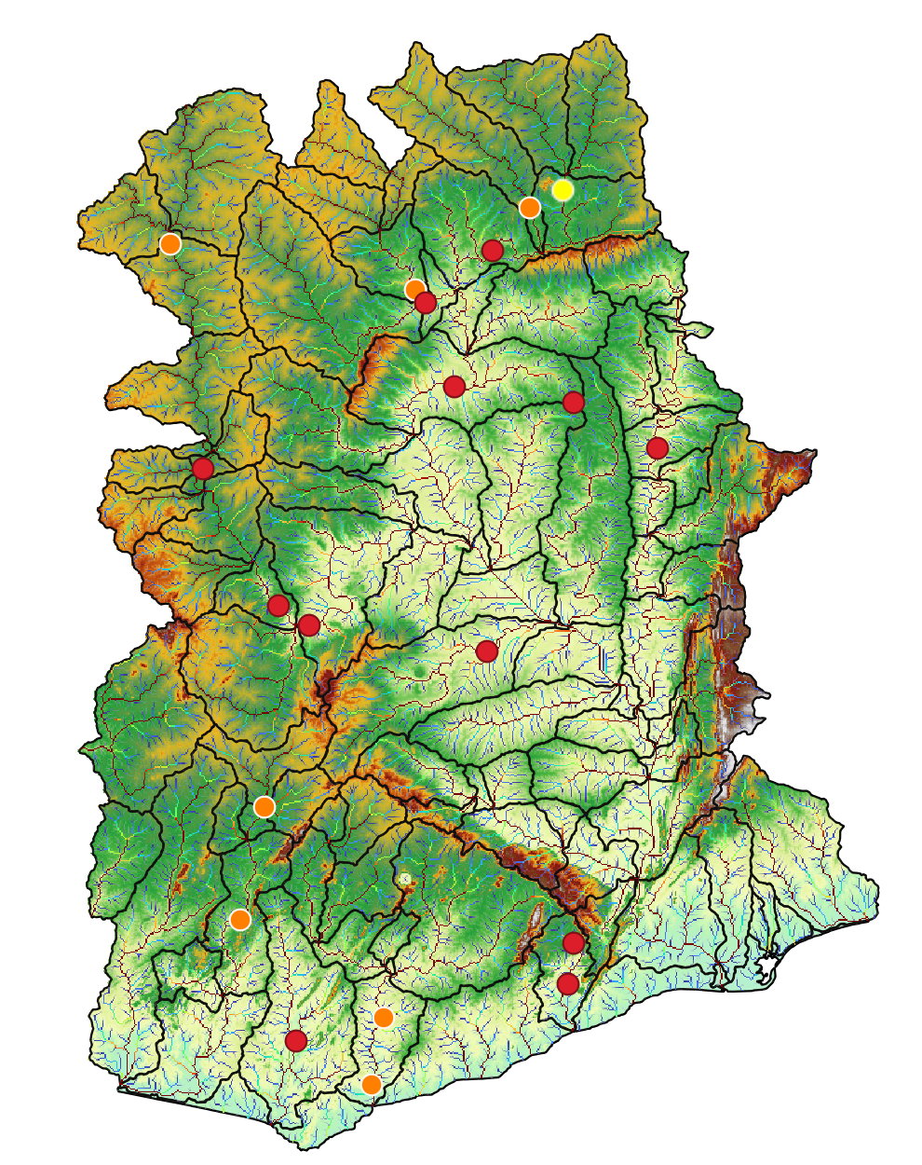
Station=1531600
Notes:
We have some prelimiry results for our ghana baseline. In most of the cases the model overestimate the discharge, however where the model subestimate the observations the NASH error is not so bad. For instance, this two stations..

Slide 7
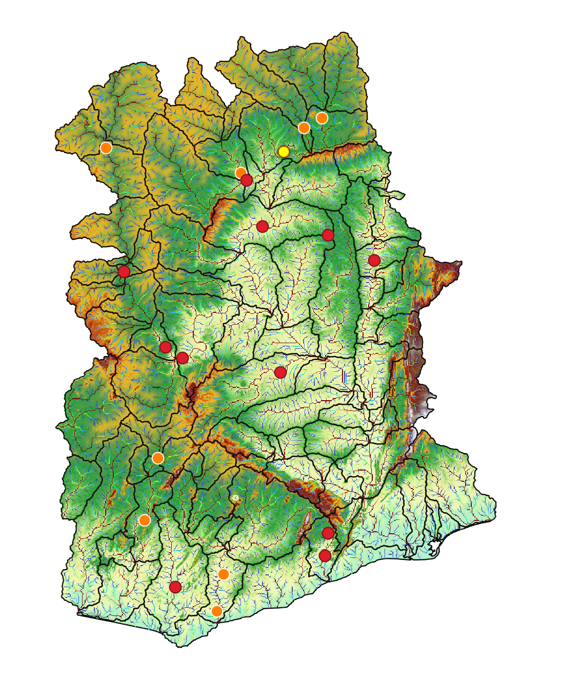
Station=1531550

Slide 8
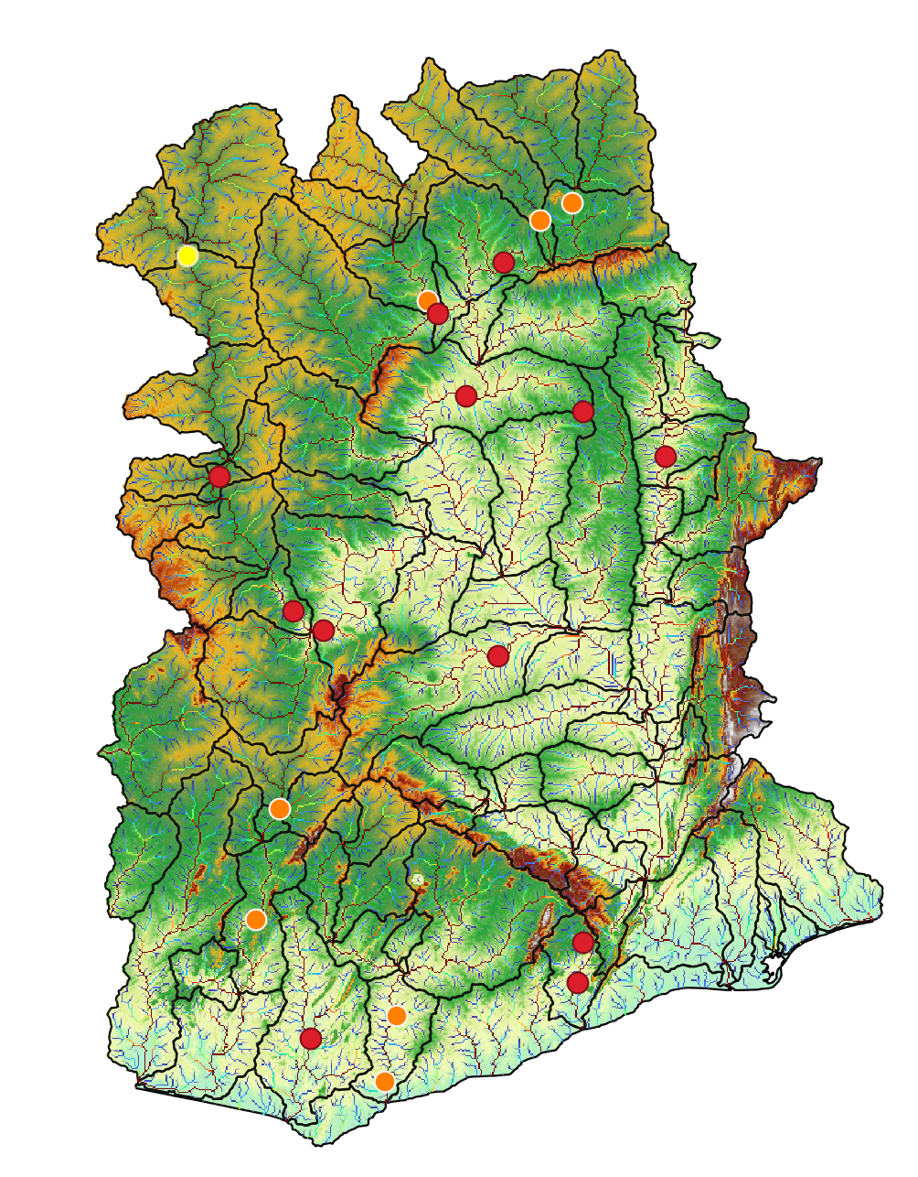
Station=1531050
Notes:
Here for example the model overestimate the observations, but with a negative nash error which is something we don’t want to

Slide 9
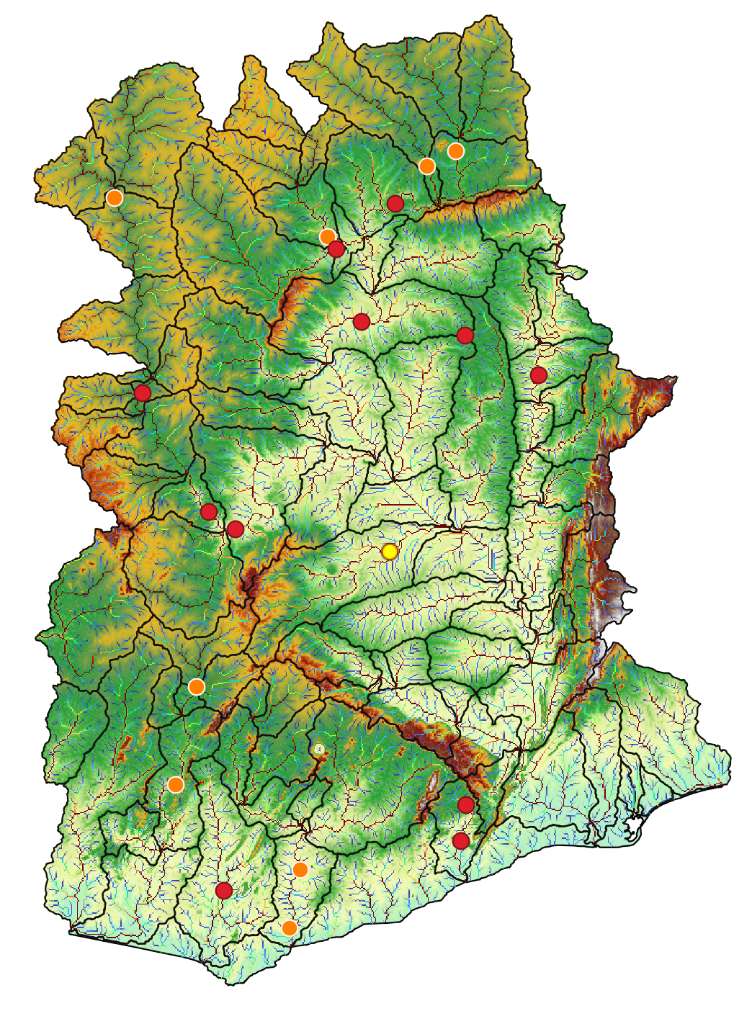
Station=1526300

Slide 10
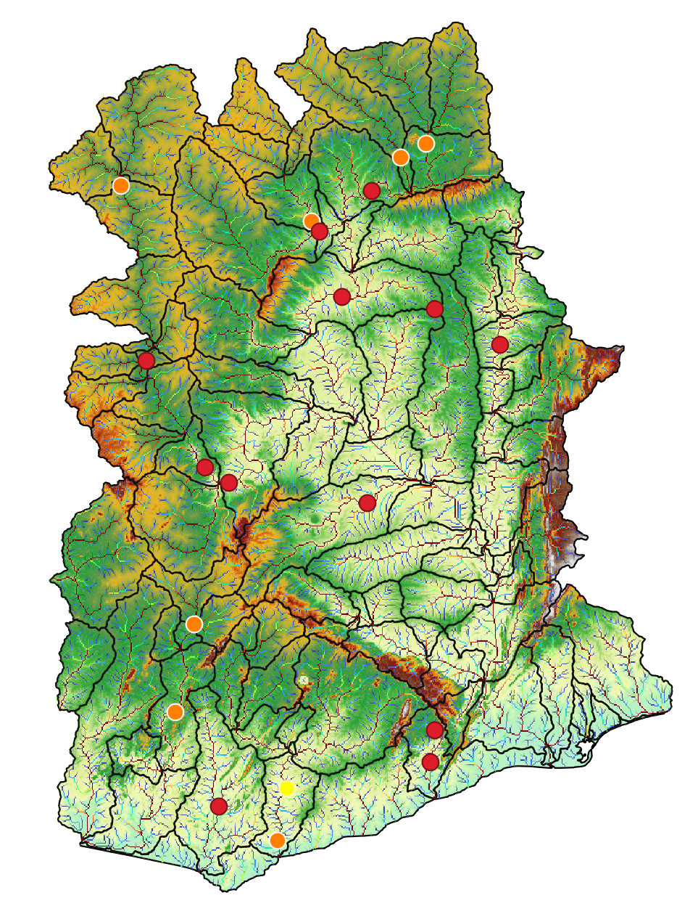
Station=5000001
Notes:
We realize that for some stations we don’t have data from the model, so we need to correct the location of the gauge.
So, this week we are going to correct that locations and run again the model to see if improves

Slide 11
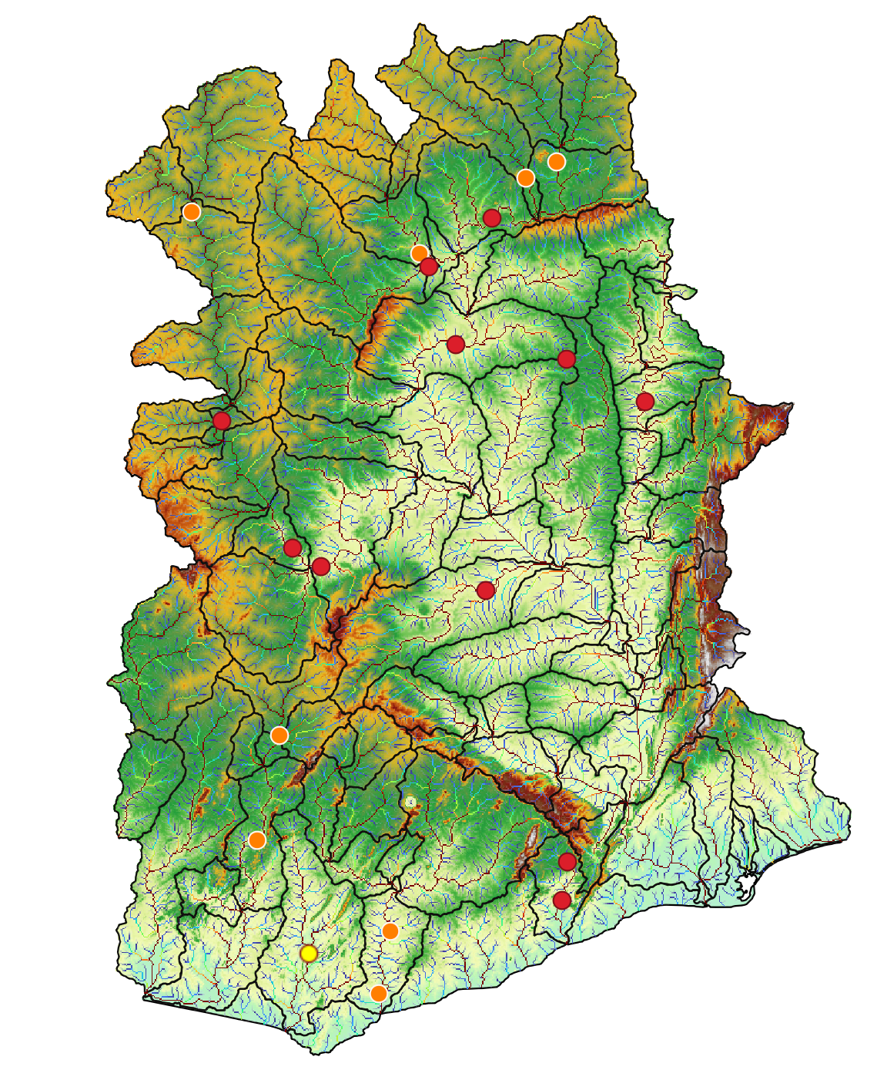
Station=1526200

Slide 12
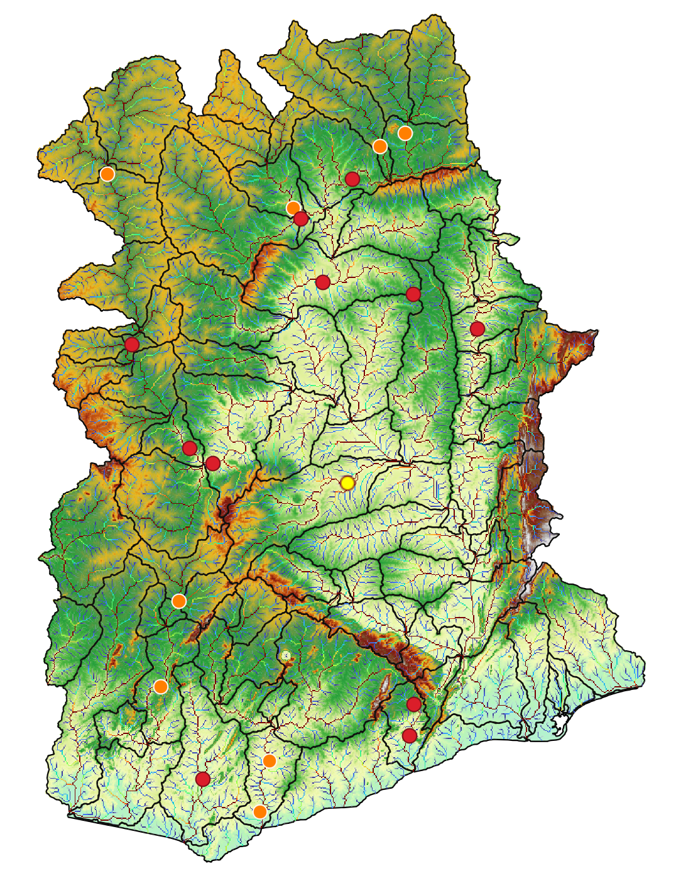
Station=1526801

Slide 13
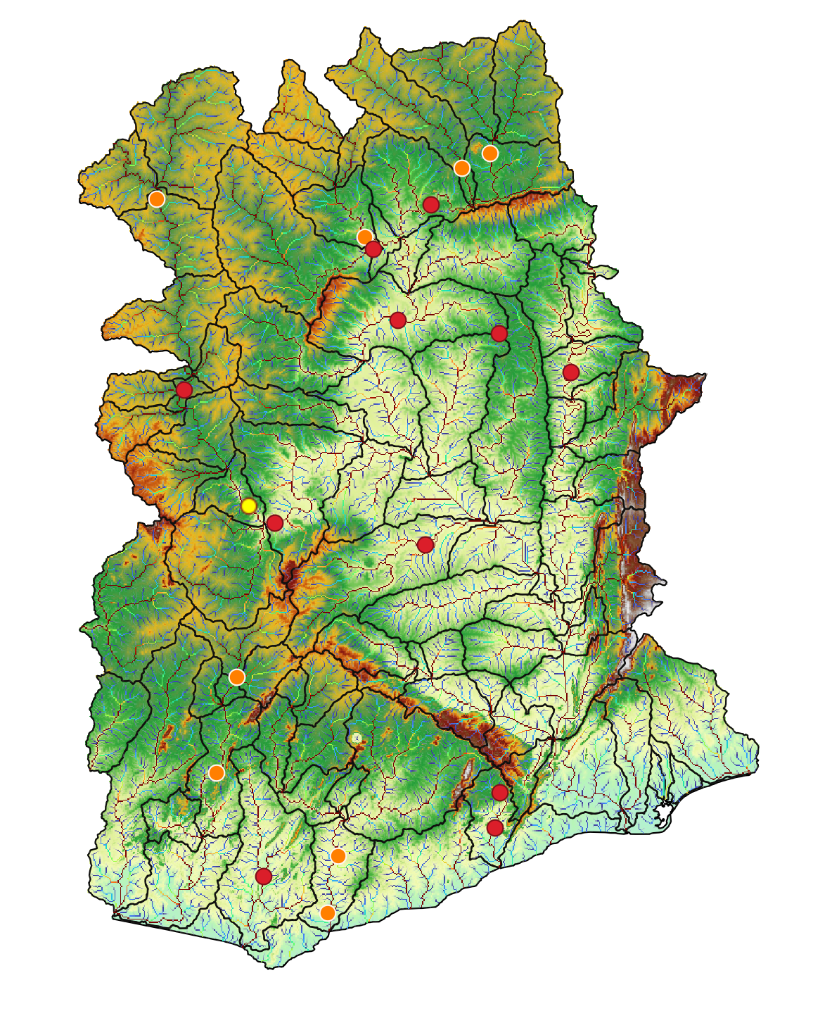
Station=1006003

Slide 14
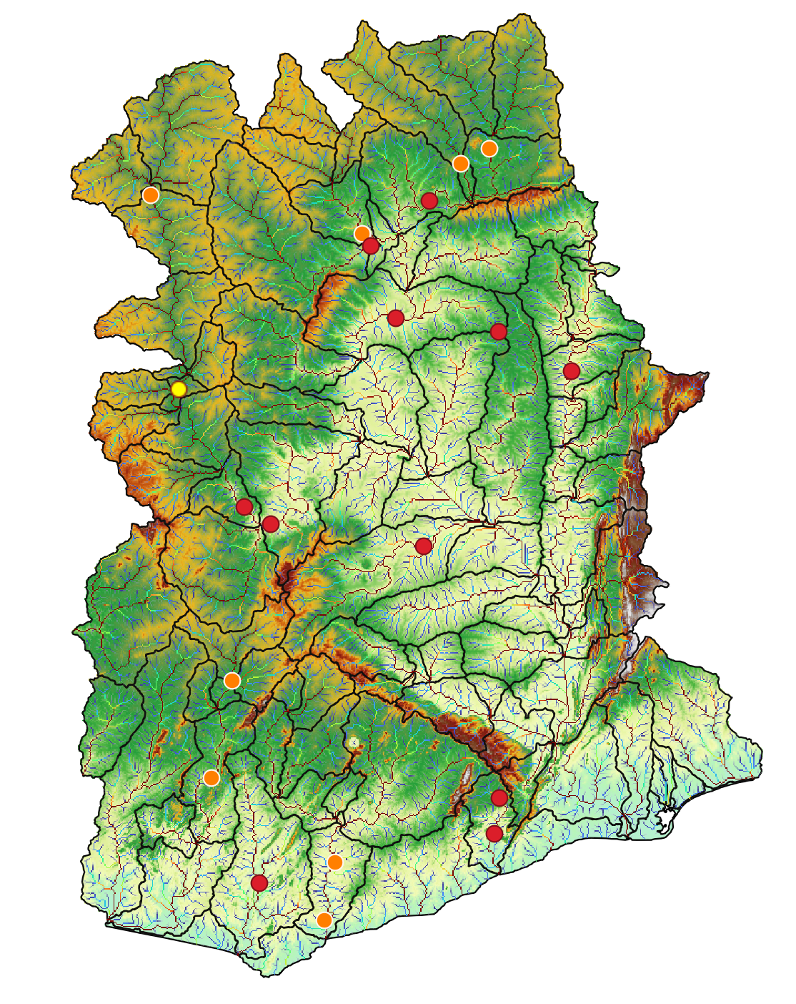
Station=1006007

Slide 15
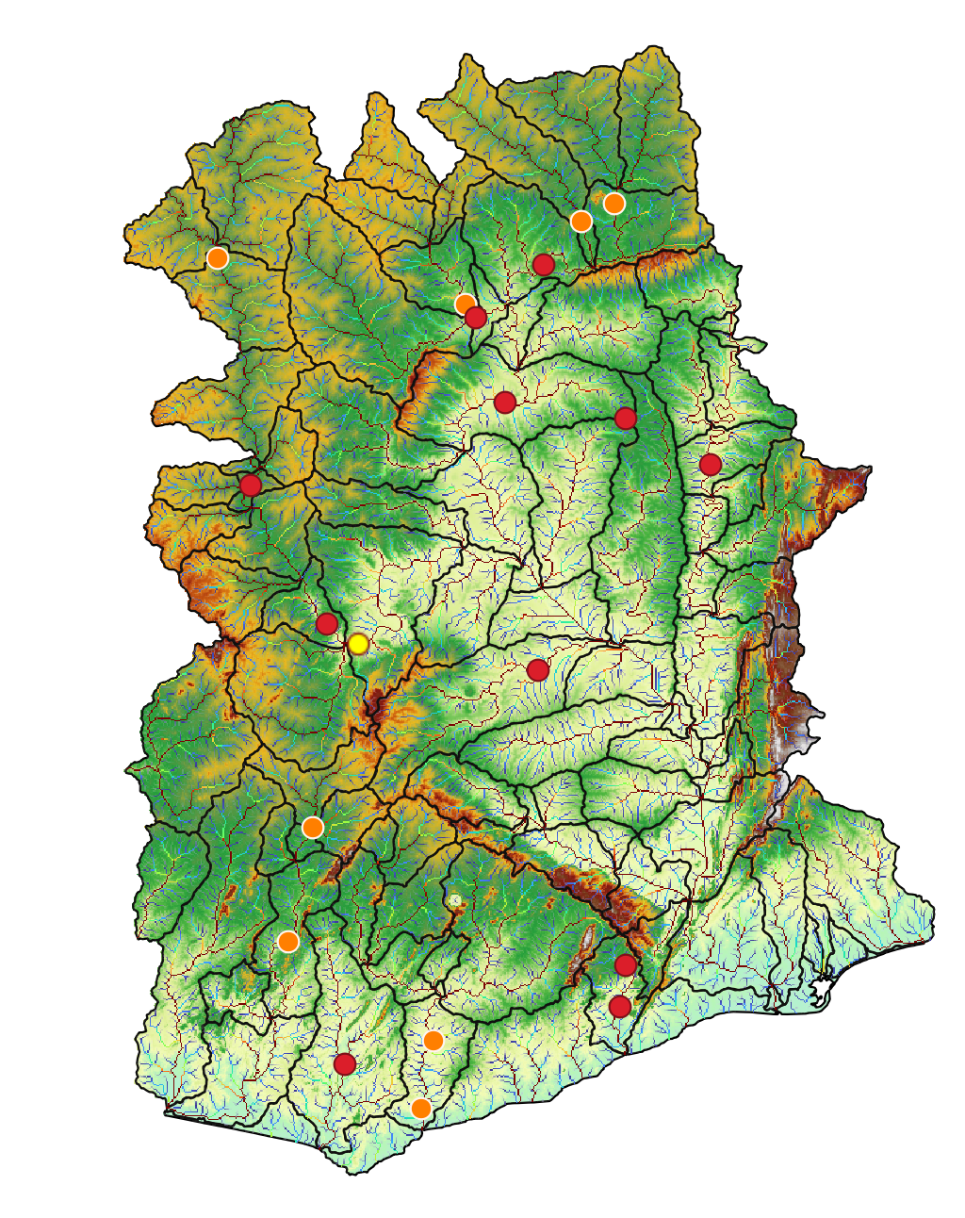
Station=1531100

Slide 16
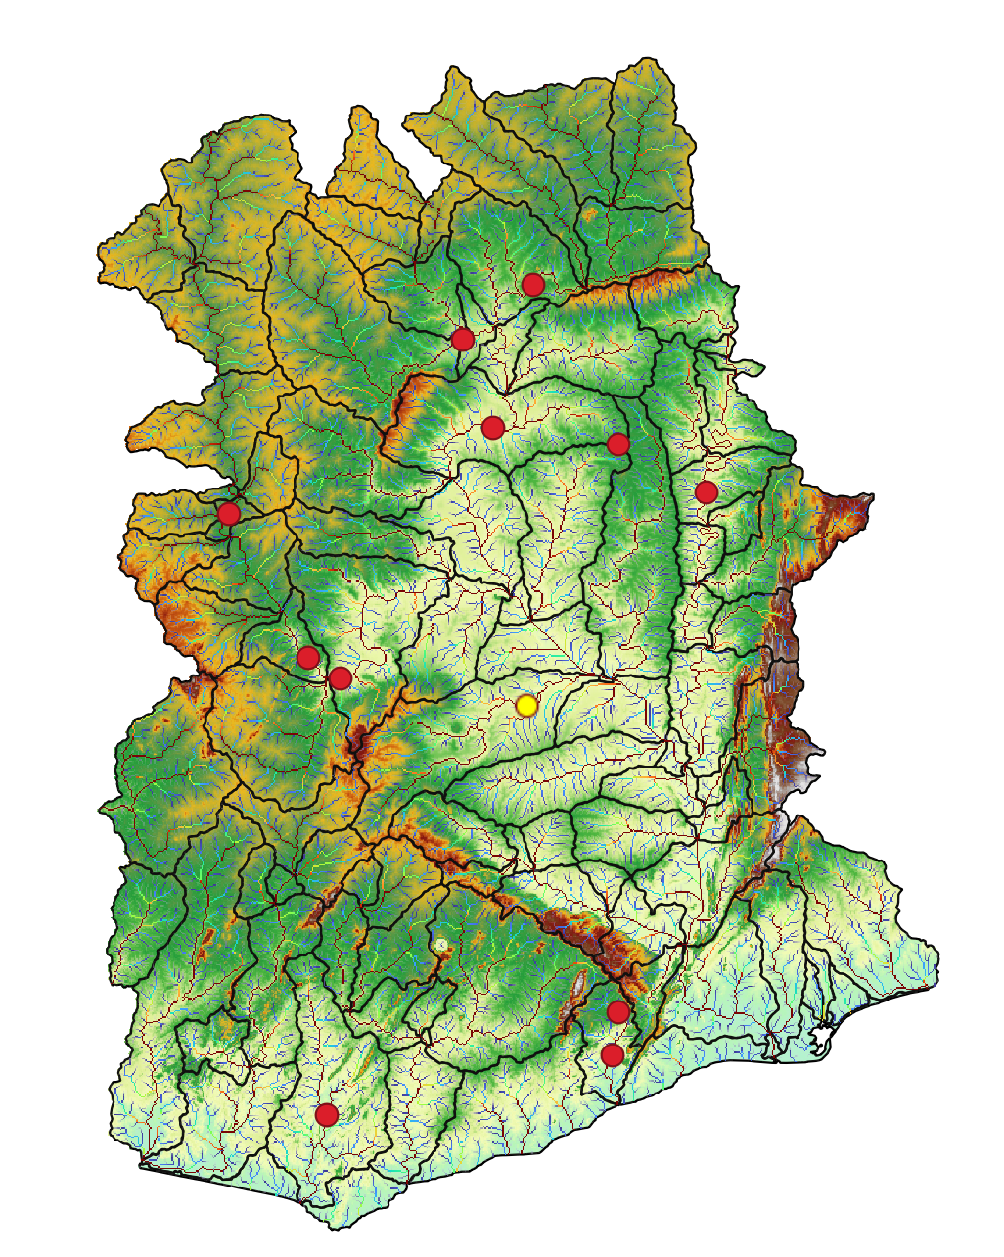
Station=1531300

Slide 17
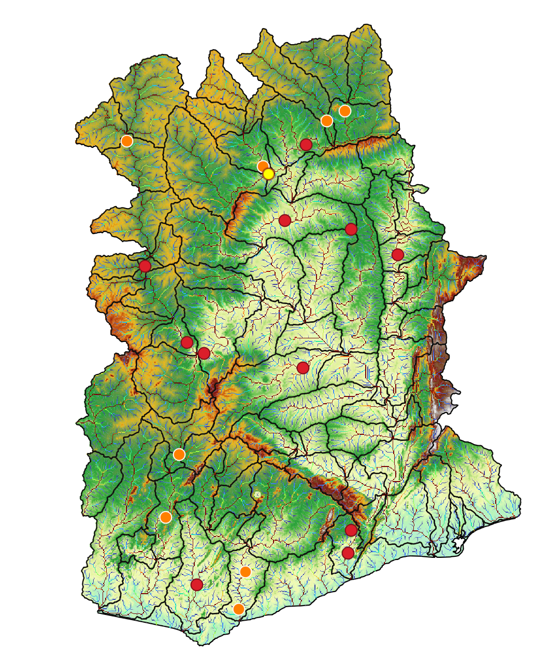
Station=1531420

Slide 18
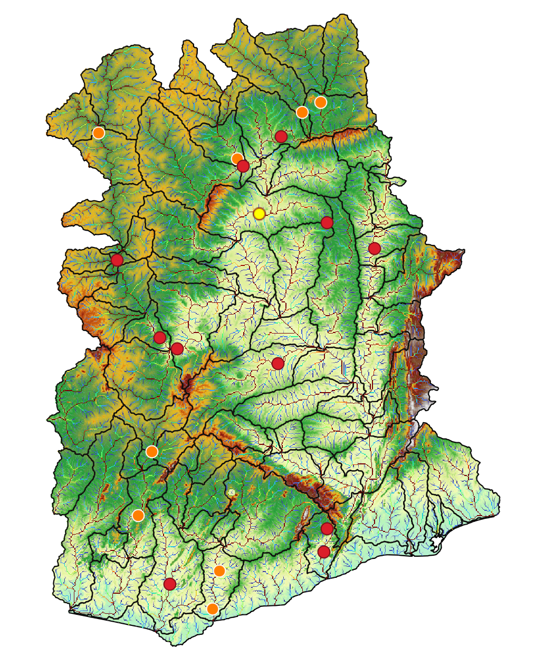
Station=1531450

Slide 19

Station=1531650

Slide 20
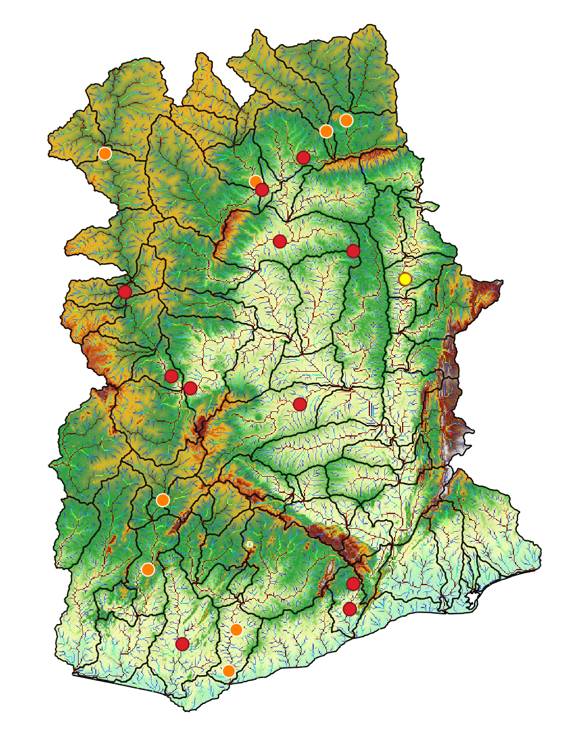
Station=1531800

Slide 21

Station=3000003

Slide 22
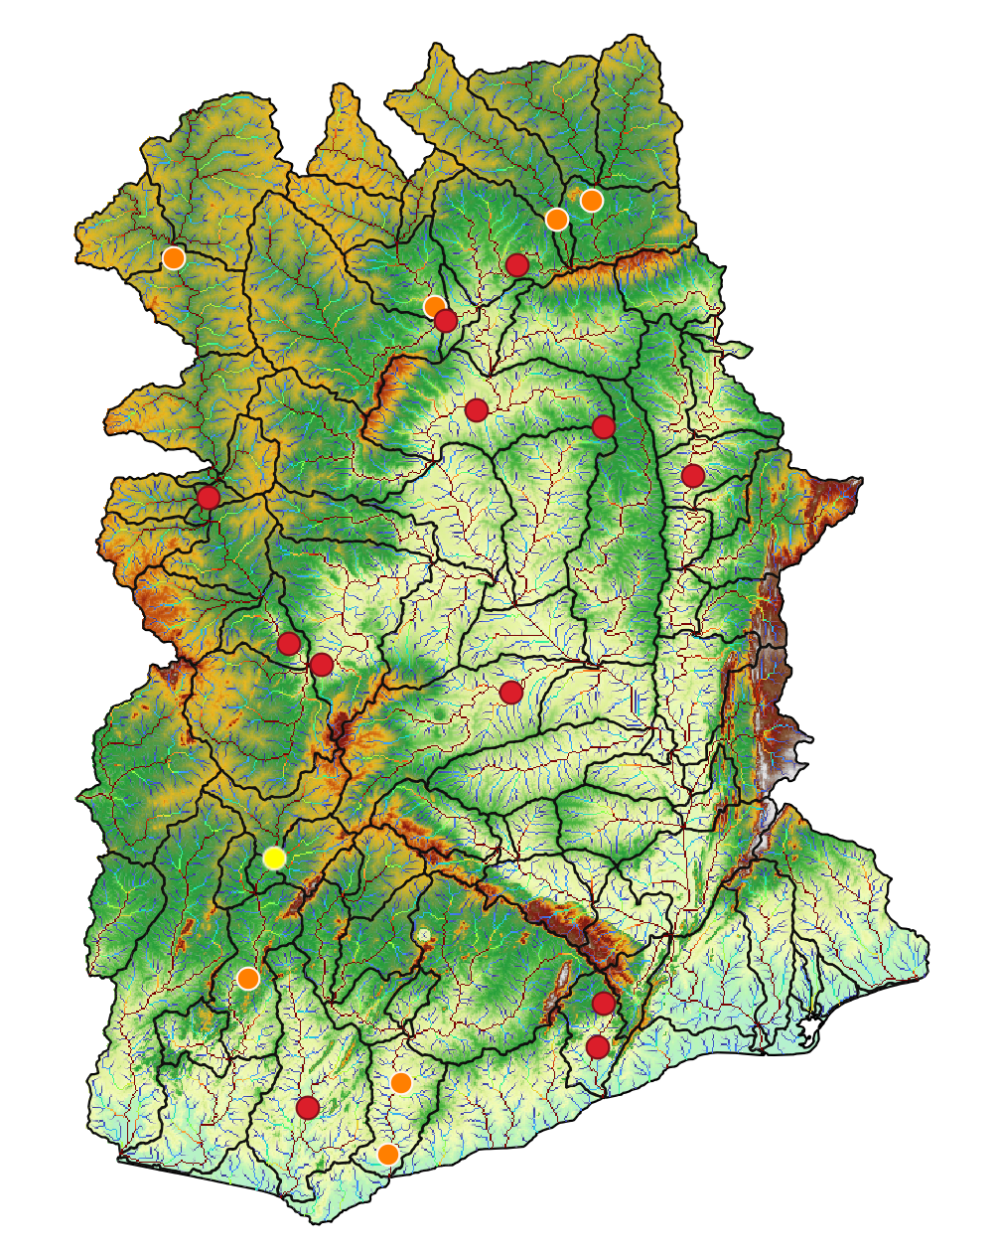
Station=3000004

Slide 23
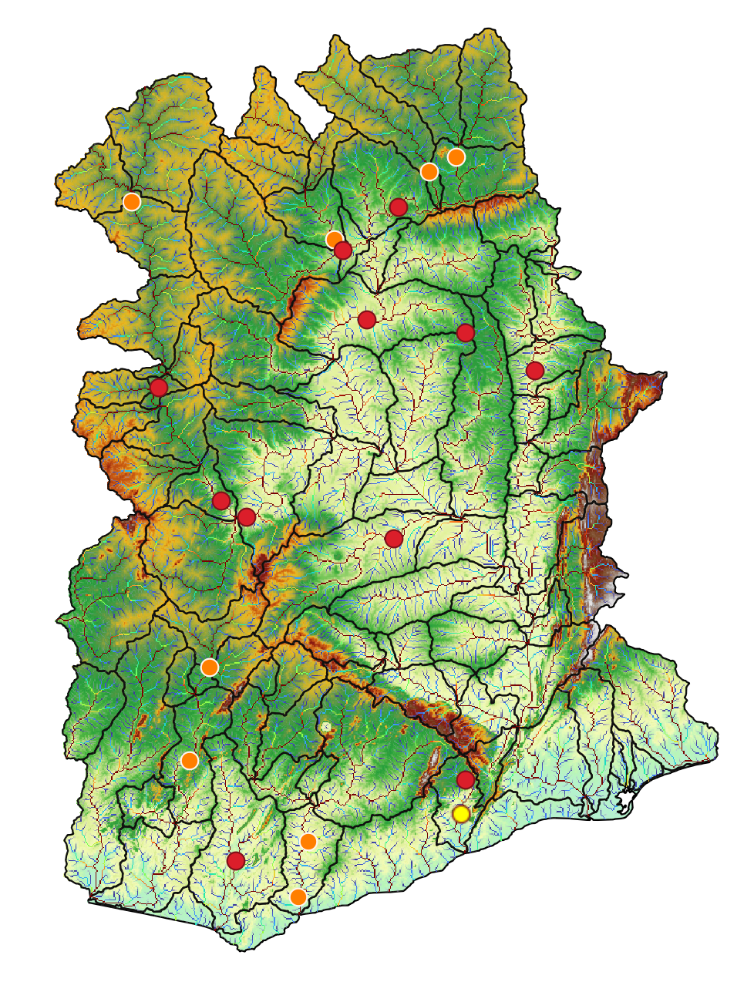
Station=9000005

Slide 24
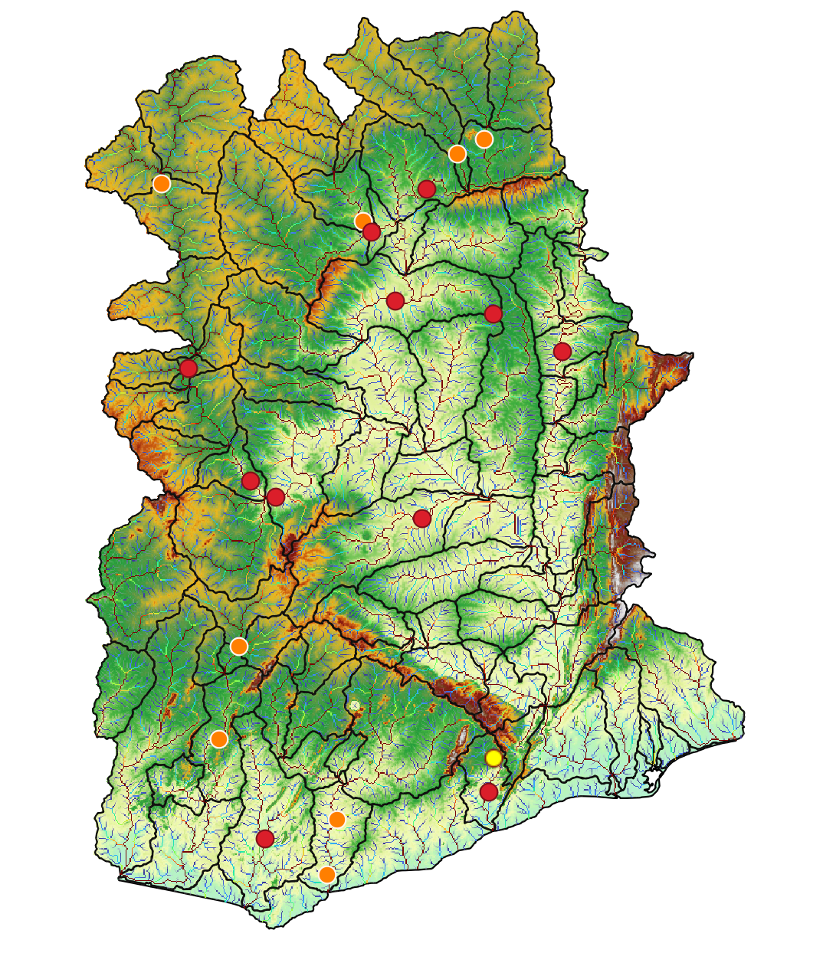
Station=9000008

